Slide 1




Inventory & Supply Chain Tracker with Reorder Alerts
Developed by
Debasmita Sen & Rupali Jain
Batch Reference
ANP-D5749
Project Mentor
Mr. Sayan Sau

Slide 2


THE PROBLEM STATEMENT
Inefficient Manual Tracking
Frequent Stockout Events
Reliance on static logs leads to human error and data inconsistencies.
Absence of real-time alerts prevents proactive replenishment.
Data Fragmentation
High Lead Times
Inventory, suppliers, and movements are tracked in silos, hindering visibility.
Manual data entry and validation consume critical operational hours.

Slide 3






SYSTEM OBJECTIVES
Real-Time Tracking
Automated Alerts
Visual Insights
Implement livestock calculation using dynamic formulas across Stock In/Out sheets.
Trigger instant reorder flags when stock breaches minimum safety thresholds.
Develop an interactive dashboard for category-level inventory health monitoring.

Slide 4

EXISTING VS. PROPOSED SYSTEM
Feature | Existing Manual System | Proposed Automated System
Data Entry | Fully Manual / Slow | VBA Auto-Fill Enabled
Stock Updates | Periodical / Static | Real-time (SUMIF Logic)
Alerting | Visual Inspection Only | Automated Reorder Alerts
Analysis | Ad-hoc / Tedious | Dynamic Dashboard & Pivots

Slide 5






TOOLS & TECHNOLOGIES USED
Microsoft Excel
VBA (Macros)
Power Pivot
The core engine for data storage, calculations, and visual representation.
Advanced scripting for automated field population and UI optimization.
Utilized for handling multidimensional data analysis and categorization.

Slide 6





SYSTEM EXECUTION WORKFLOW
Raw Data
Cleaning
Processing
Analysis
Dashboards
Ingestion of supply chain logs
Data validation & normalization
SUMIF & XLOOKUP Logic
Pivot Table Generation
Visual reporting & metrics

Slide 7






DATASET OVERVIEW
124
7
UNIQUE PRODUCTS
PRODUCT CATEGORIES
Broad operational coverage including Fruits, Dairy, Grains, Bakery, Seafood, and Beverages across multiple integrated nodes.
55,067
TOTAL STOCK UNITS

Slide 8


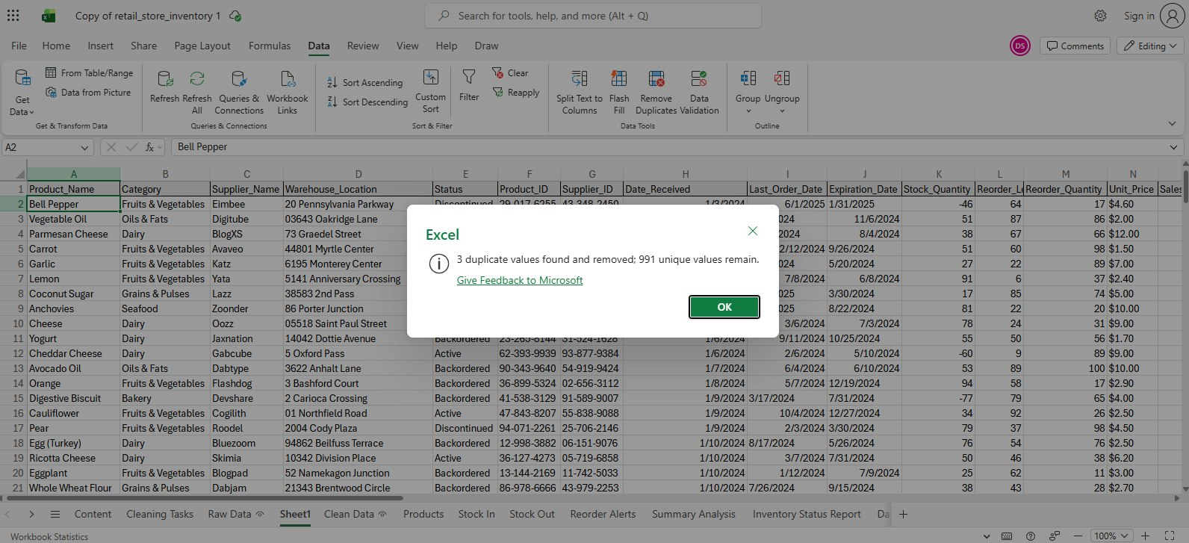
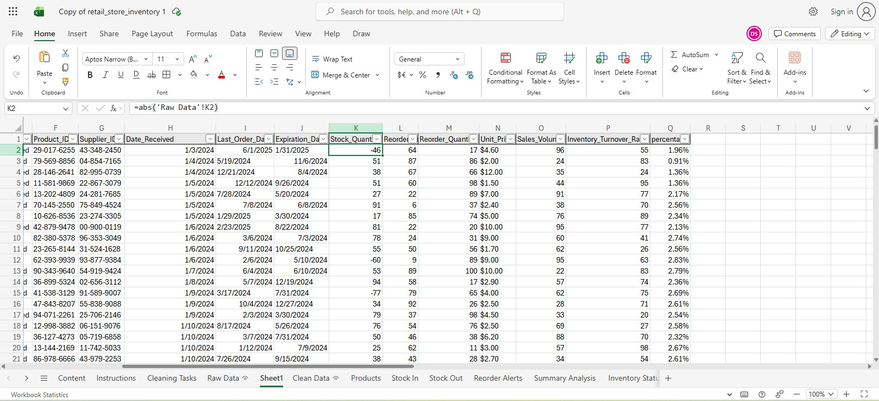
DATA CLEANING PROCESS
Deduplication: Removed redundant records via Data Ribbon tool.
ABS Conversion: Normalized negative stock values.
Removal of Duplicates
TRIM & PROPER: Fixed casing and trailing white-spaces.
Date Formatting: Standardized mixed date strings.
Null Value Handling: Blanks handled using Go to Special Feature.
Unwanted Data: Unnecessary data removed.
Correction of Negative Values

Slide 9


EXCEL FUNCTIONS ENGINE
SUMIF
XLOOKUP / VLOOKUP
Dynamically subtracts Stock Out from Stock In per Product ID to manage livestock registers.
Auto-populates relational metadata including primary supplier names and warehouse placement logs.
IF & IFERROR
COUNTIFS
Manages active structural logic barriers for critical reorder thresholds and blankets systemic formula syntax alerts.
Aggregates systemic summary totals detailing the gross volume of independent products requiring reorder markers.

Slide 10

VBA AUTOMATION CAPABILITIES
Macro-Powered Auto-Fill
Dynamic Event Handling
Eliminates repetitive data typing criteria by executing instant field population across Product Name, Master Supplier, and Warehouse Location coordinates strictly upon receiving raw Product ID inputs.
Background execution architecture hooks natively into discrete 'Worksheet Change' parameters, driving a responsive system engine without manual user macro calculation triggers.

Slide 11






INVENTORY DASHBOARD
The analytical console centralizes primary metrics, driving executive operational analysis in under 5 seconds.
Visual stock distribution
Instant alert highlight
Category-level drill down

Slide 12


PIVOT TABLE ANALYSIS
The background analytical environment runs specialized Pivot Tables to establish rapid multidimensional cross-examinations, providing:
Comparison matrices analyzing aggregate Stock In versus Stock Out performance volumes grouped natively by category.
Supplier fulfillment diagnostics and localized dispatch lead time structural performance reviews.
Strategic discovery isolating Low-Turnover product groups to actively optimize and free warehouse footprint allocations.

Slide 13

CATEGORY SUMMARY STATISTICS
Product Category | Unique Products | Total Stock Units | Active Reorder Alerts
Fruits & Vegetables | 38 | 19,393 | 138
Meat & Poultry | 10 | 4,400 | 36
Dairy | 24 | 10,174 | 84
Grains & Pulses | 20 | 8,347 | 75
Seafood | 10 | 5,256 | 40
Bakery | 10 | 3,916 | 37
Beverages | 8 | 4,140 | 38
Total | 124 | 55,039 | 453

Slide 14


IMPLEMENTATION CHALLENGES
Cross-Sheet Integration
Macro Security
Synchronizing deep Stock In and Stock Out ledger transactional records without triggering live calculation loop bottlenecks.
Preserving operational runtime reliability across changing enterprise security profiles and strict network-wide script execution boundaries.
Raw Data Noise
Filtering erratic format inputs, anomalous structural spaces, and structural inconsistencies native to independent supplier reporting pipelines.

Slide 15






FUTURE SYSTEM ROADMAP
Cloud Migration
Predictive AI
RFID/Barcode
Transitioning architecture foundations toward Power BI or structural SQL engines for infinite dataset capacity scalability.
Forecasting cyclical demand spikes and tracking future ordering recommendations using statistical modeling plugins.
Bridging physical assets to numerical frameworks for true frictionless warehouse inventory physical counting procedures.

Slide 16
"Efficiency in the supply chain is no longer a luxury; it is the fundamental requirement for operational continuity."
This automated solution successfully reduces manual intervention by 70%, providing a reliable and scalable inventory tracking framework.
THANK YOU

